Slide 1
Design Crits

Slide 2
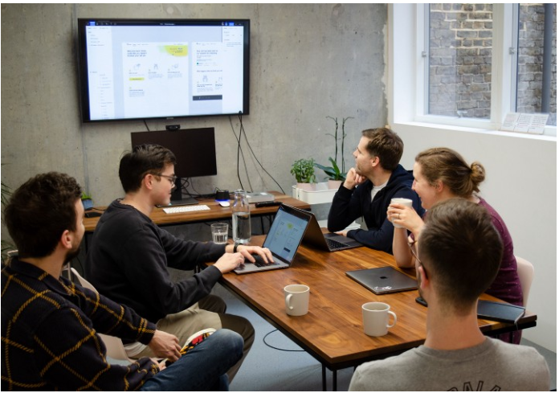
What is Crit?
A crit (short for critique) is a get-together of designers and others to share and comment on work-in-progress designs.

Slide 3
Design Crit Framework: Prof. Jeffrey Bardzell
Advocate for 4 perspectives
Use and user experience
Design
Ecology/context or situation, and
Taking the work forward

Slide 4
Use and user experience
This crit focuses on stakeholders and user experiences. Try to provide feedback based on following aspects:
Who is the user/stakeholder?
What does she/he know already?
What does s/he want to know or understand better?
What skills does the user have, and what are needed to complete relevant tasks?
What aspects of the work are hard, frustrating, and/or prone to breakdowns?
If this were to be a very fulfilling and meaningful user experience, what would that look like?

Slide 5
Design
This crit focuses on design artifacts:
What are the concrete design artifacts (this includes products and devices, but also design components, such as personas, diagrams, maps, etc.)?
What are their qualities or characteristics?
Where do they show (or fail to show) craftsmanship?
What other designs have qualities like these?
What are the relevant forms, patterns, and materials—and what do they mean or imply?
Who is the “user” inscribed in the design?
How does the design enable action, and what kinds of action does it enable?

Slide 6
Ecology, Situation, or Context
This crit focuses on ecology or contexts:
What is the situation or context in which users or stakeholders engage these designs?
What barriers, challenges, or contradictions are part of the context or situation?
Who are some of the other stakeholders (beyond the user) and what are their stakes in the design?
What is the competitive/business/market environment that this is happening in?

Slide 7
Taking the Work Forward
This crit focuses on “what I would do?”:
What would you do if you suddenly had to take over the project from this point forward?
What do you wish you knew better?
If you were responsible for this, what would worry you?
And what would excite you, were you to carry this forward?
What would you do next?
What about what you have seen would especially shape your next steps?

Slide 8
Design Crits Speed Dating Protocol

Slide 9
One Full Round of Crits in 11 minutes
Each group take one of the following five roles:
the presenter ( 3 minutes)
- shows a design (e.g., prototype your group is using for usability test)
- present the design
- offers some contexts to it
an advocate for use and user experience (90 seconds)
an advocate for design (90 seconds)
an advocate for the ecology/context or situation, and (90 seconds)
an advocate for taking the work forward (90 seconds)
Conclusion (90 seconds)
The presenter repeats back to the group what s/he heard, and summarizes how
Change the roles after each round

